Slide 1
BlueBell
Parul Institute of Computer Applications
Semester IV Project
2024-25
Ankit Singh Giri Siddharth Nishant Rohin
2305103140003. 2305103140013 2305103140019
Bluebell – Use the best , website to show how cryptography , encryption works .

Slide 2
INDEX
Abstract
Comparison of New System with Existing System
Technology and HW, SW Requirement Specification
Modules and its short description
Users and their role description
Limitations
References & Bibliography

Slide 3
Abstract
"This project integrates cryptography, steganography, and QR code generation in a unified web interface to enhance data security and concealment. It provides a seamless solution for encrypting data, hiding it within media files, and encoding it as QR codes for secure transmission.“
"By combining these technologies, the project offers a comprehensive approach to secure communication in modern-day applications."

Slide 4
Comparison of new system with existing system
Existing Systems:
Cryptography and steganography are often implemented separately.
Existing systems might lack user-friendly interfaces.
QR code applications are primarily focused on data sharing, not security.
New System:
Combines all three techniques in one platform.
Enhances usability and efficiency.
Provides multilayered security: encryption (data protection), steganography
(concealment), and QR codes (sharing medium).
Benefits:
Higher security.
Simplified workflow.
Broader applicability for secure messaging, file sharing, and data storage.

Slide 5
Technology and HW, SW Requirement Specification
Technologies Used:
Frontend: HTML, CSS, JavaScript.
Backend: Python/Node.js (mention specific frameworks like Flask/Django if used).
QR Code Library: Mention tools like qrcode for Python or any JavaScript
QR library.
Hardware Requirements:
Minimum: Core i3 processor, 4GB RAM.
Recommended: Core i5 or higher, 8GB RAM, 500GB storage.
Software Requirements:
Web browser (Google Chrome/Firefox).
Operating system: Windows, macOS, or Linux.
Python/Node.js runtime environment.
Any IDE (Visual Studio Code, PyCharm).

Slide 6
Modules and its short description
Module 1: Cryptography
Encrypts user data using algorithms like AES or RSA.
Ensures data confidentiality.
Module 2: Steganography
Hides encrypted data within image or audio files.
Provides an additional layer of security.
Module 3: QR Code Generation
Converts the concealed/encrypted data into a scannable QR code.
Facilitates secure data sharing.
Module 4: User Interface
Simple, intuitive web interface to integrate all functionalities.

Slide 7
Features and its short description
Data Hiding: Conceals encrypted data within images or audio files.
QR Code Generation: Converts encrypted data into scannable QR codes.
QR Code Decoding: Retrieves and decrypts hidden data from QR codes.
Web-Based Interface: User-friendly platform for seamless interaction.
File Upload: Allows uploading files for embedding or extracting data.
Algorithm Options: Supports multiple encryption methods.
Cross-Platform: Accessible on any browser-enabled device.
Real-Time Preview: Shows live QR code generation.
Secure Sharing: Combines encryption, steganography, and QR
for secure communication

Slide 8
Users and their role description
Admin:
Oversees system functionality.
Manages encryption algorithms and QR code configurations.
End Users:
Inputs data for encryption.
Uploads files for steganography.
Scans and decodes QR codes to retrieve data.

Slide 9
Limitations
Limited to small file sizes for steganography
(e.g., low image resolution).
Security depends on the strength of the cryptographic algorithm.
QR codes might not support large datasets directly
(may require segmentation).

Slide 10
Future Enhancement
Support for Multiple Cryptographic Algorithms
Add support for algorithms like Elliptic Curve Cryptography (ECC)
or hybrid algorithms to offer flexibility and stronger security.
Steganography for Video and Audio Files
Extend steganography functionality to support embedding data
within video or audio files, increasing its use cases in multimedia security.
Dynamic QR Code Generation
Develop dynamic QR codes that update data in real-time, useful for scenarios
like live authentication or secure payments.
Mobile Application Integration
Create a companion mobile app for Android and iOS to scan and decode QR
codes directly, enhancing accessibility.
End-to-End Encryption with Blockchain
Integrate blockchain technology for decentralized storage and
validation of encrypted data.

Slide 11
References & Bibliography
- The Code Book: The Science of Secrecy from Ancient Egypt to Quantum Cryptography – Simon Singh
Information Hiding: Techniques for Steganography and Digital Watermarking – Stefan Katzenbeisser, Fabien A. P. Petitcolas
Modern Cryptography: Theory and Practice – Wenbo Mao
Homomorphic Encryption and Applications – Kristin Lauter, Nigel P. Smart
"Practical Cryptography in Python: Learning by Implementing" – Seth James Nielson, Christopher K. Monson
AI – chatgpt , deepseek , gemini
www.google.com

Slide 12
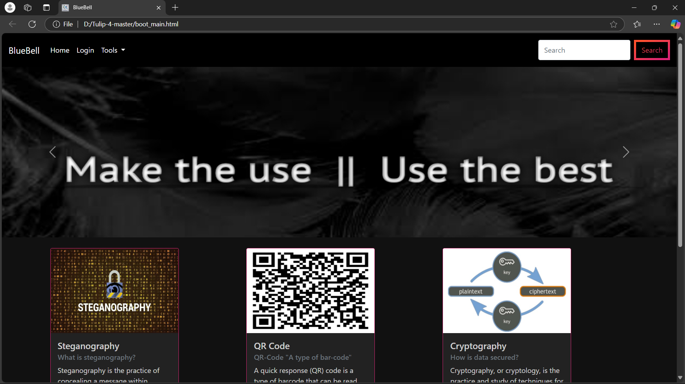
SOME SCREENSHOTS OF THE PROJECT ( INCOMPLETE ).

Slide 13
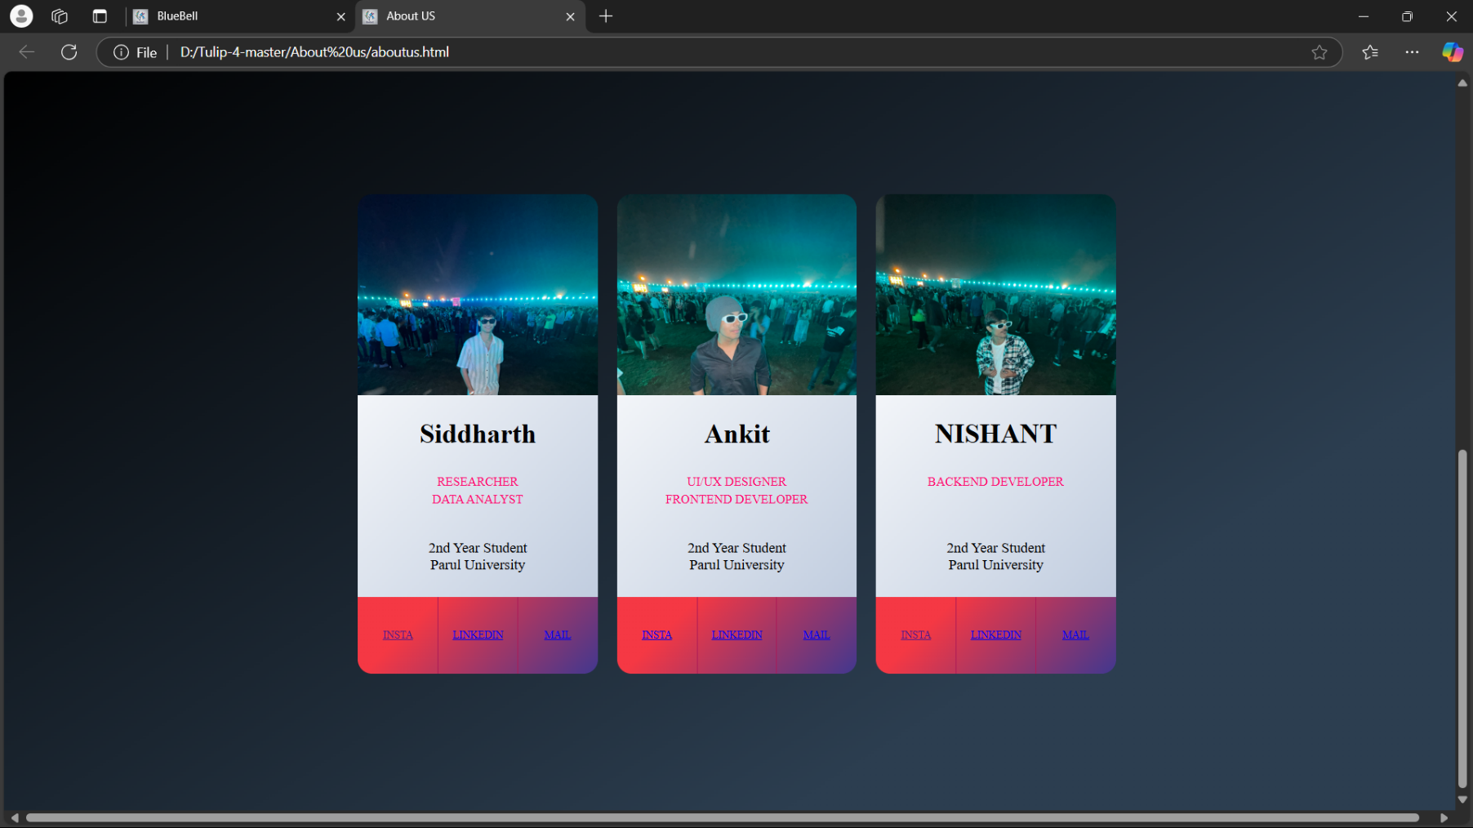
Developers

Slide 14
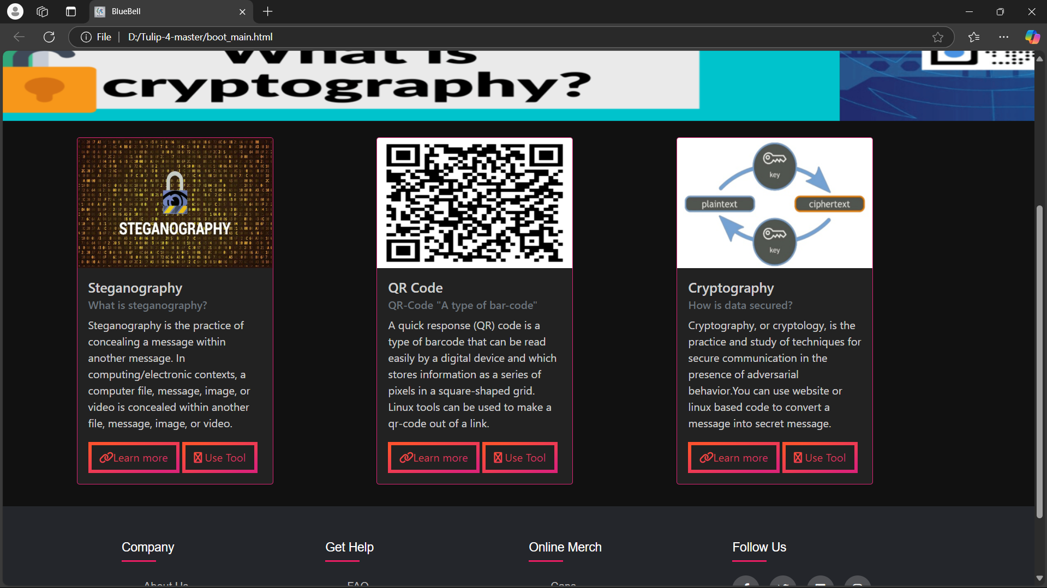
Main page

Slide 15
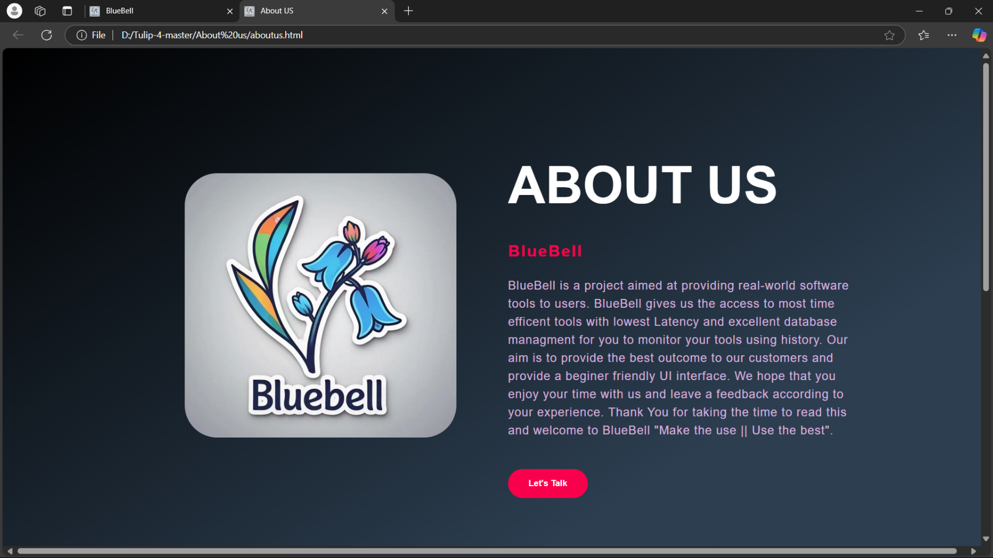
Description

Slide 16

Thank you !!!

